Slide 1
What is OBOB?
OBOB stands for Oregon Battle of the Books!
The Battle of the Books is a friendly reading competition. You will get into teams of 4-5 students and read a list of 16 books. You do NOT have to read all 16 unless you want to! I suggest reading about 4 or 5 of the books. To battle, your team will compete against one other team answering questions about the books from the list. Let’s take a look at the books!!

Slide 2
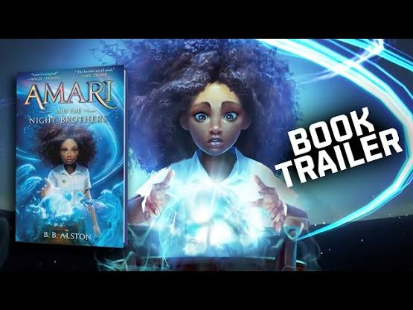
Amari and The Night Brothers
by B.B. Alston
► 0:30
Amari Peters has never stopped believing her missing brother, Quinton, is alive. Not even when the police told her otherwise, or when she got in trouble for standing up to bullies who said he was gone for good.
So when she finds a ticking briefcase in his closet, containing a nomination for a summer tryout at the Bureau of Supernatural Affairs, she’s certain the secretive organization holds the key to locating Quinton—if only she can wrap her head around the idea of magicians, fairies, aliens, and other supernatural creatures all being real.
Now she must compete for a spot against kids who’ve known about magic their whole lives. No matter how hard she tries, Amari can’t seem to escape their intense doubt and scrutiny—especially once her supernaturally enhanced talent is deemed “illegal.” With an evil magician threatening the supernatural world, and her own classmates thinking she’s an enemy, Amari has never felt more alone. But if she doesn’t stick it out and pass the tryouts, she may never find out what happened to Quinton.

Slide 3
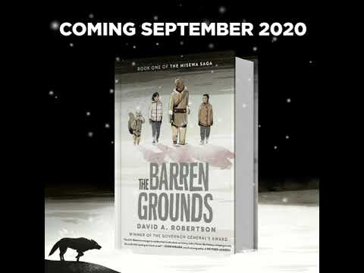
The Barren Grounds
by David A. Robertson
Morgan and Eli, two Indigenous children forced away from their families and communities, are brought together in a foster home in Winnipeg, Manitoba. They each feel disconnected, from their culture and each other, and struggle to fit in at school and at their new home -- until they find a secret place, walled off in an unfinished attic bedroom. A portal opens to another reality, Askí, bringing them onto frozen, barren grounds, where they meet Ochek (Fisher). The only hunter supporting his starving community, Misewa, Ochek welcomes the human children, teaching them traditional ways to survive. But as the need for food becomes desperate, they embark on a dangerous mission. Accompanied by Arik, a sassy Squirrel they catch stealing from the trapline, they try to save Misewa before the icy grip of winter freezes everything -- including them.

Slide 4
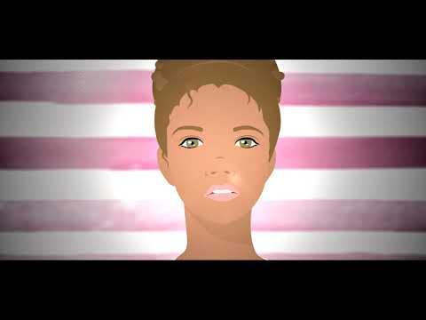
Eleven-year-old Isabella’s parents are divorced, so she has to switch lives every week: One week she’s Isabella with her dad, his girlfriend Anastasia, and her son Darren living in a fancy house where they are one of the only black families in the neighborhood. The next week she’s Izzy with her mom and her boyfriend John-Mark in a small, not-so-fancy house that she loves.
Because of this, Isabella has always felt pulled between two worlds. And now that her parents are divorced, it seems their fights are even worse, and they’re always about HER. Isabella feels completely stuck in the middle, split and divided between them more than ever. And she is beginning to realize that being split between Mom and Dad involves more than switching houses, switching nicknames, switching backpacks: it’s also about switching identities. Her dad is black, her mom is white, and strangers are always commenting: “You’re so exotic!” “You look so unusual.” “But what are you really?” She knows what they’re really saying: “You don’t look like your parents.” “You’re different.” “What race are you really?” And when her parents, who both get engaged at the same time, get in their biggest fight ever, Isabella doesn’t just feel divided, she feels ripped in two. What does it mean to be half white or half black? To belong to half mom and half dad? And if you’re only seen as half of this and half of that, how can you ever feel whole?
Blended
by Sharon Draper

Slide 5
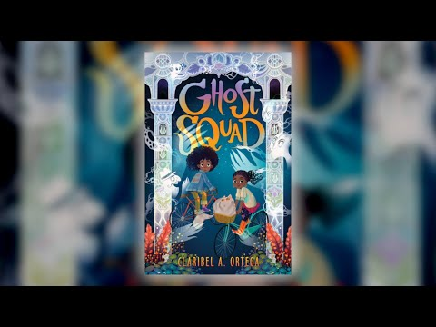
Ghost Squad
by Claribel A. Ortega
For Lucely Luna, ghosts are more than just the family business.
Shortly before Halloween, Lucely and her best friend, Syd, cast a spell that accidentally awakens malicious spirits, wreaking havoc throughout St. Augustine. Together, they must join forces with Syd's witch grandmother, Babette, and her tubby tabby, Chunk, to fight the haunting head-on and reverse the curse to save the town and Lucely's firefly spirits before it's too late.
With the family dynamics of Coco and action-packed adventure of Ghostbusters, Claribel A. Ortega delivers both a thrillingly spooky and delightfully sweet debut novel.

Slide 6
The Girl From The Sea
by Molly Knox Ostertag
From the author of The Witch Boy trilogy comes a graphic novel about family, romance, and first love.
Fifteen-year-old Morgan has a secret: She can't wait to escape the perfect little island where she lives. She's desperate to finish high school and escape her sad divorced mom, her volatile little brother, and worst of all, her great group of friends...who don't understand Morgan at all. Because really, Morgan's biggest secret is that she has a lot of secrets, including the one about wanting to kiss another girl.Then one night, Morgan is saved from drowning by a mysterious girl named Keltie. The two become friends and suddenly life on the island doesn't seem so stifling anymore.But Keltie has some secrets of her own. And as the girls start to fall in love, everything they're each trying to hide will find its way to the surface...whether Morgan is ready or not.

Slide 7
Girl in the Blue Coat by Monica Hesse
Amsterdam, 1943. Hanneke spends her days procuring and delivering sought-after black market goods to paying customers, her nights hiding the true nature of her work from her concerned parents, and every waking moment mourning her boyfriend, who was killed on the Dutch front lines when the Germans invaded. She likes to think of her illegal work as a small act of rebellion.
On a routine delivery, a client asks Hanneke for help. Expecting to hear that Mrs. Janssen wants meat or kerosene, Hanneke is shocked by the older woman's frantic plea to find a person--a Jewish teenager Mrs. Janssen had been hiding, who has vanished without a trace from a secret room. Hanneke initially wants nothing to do with such dangerous work, but is ultimately drawn into a web of mysteries and stunning revelations that lead her into the heart of the resistance, open her eyes to the horrors of the Nazi war machine, and compel her to take desperate action.

Slide 8
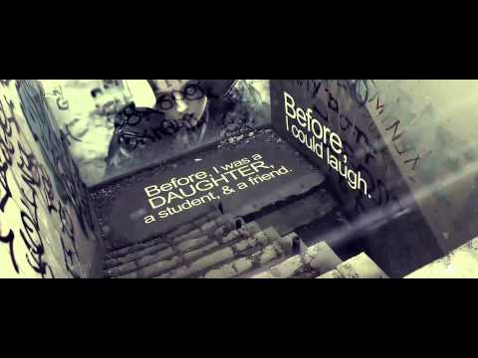
In the After by Demitria Lunetta
Attack.
Not isolated.
Fate of Americans: unknown.
Amy is watching TV when the world is attacked by Them. Most of the population is overtaken, but Amy manages to survive - and even rescue "Baby" - a toddler she finds in an abandoned supermarket.
Then, after years of hiding, they are miraculously rescued and taken to New Hope, a colony of survivors living in a former government research compound. While at first the colony seems like a dream, with plenty of food, safety, and shelter, New Hope slowly reveals that it is far from ideal. And Amy soon realizes that unless things change, she'll lose Baby - and much more.
You'll tear through the pulse-pounding narrow escapes and horrifying twists of fate in this thrilling debut from author Demitria Lunetta.

Slide 9
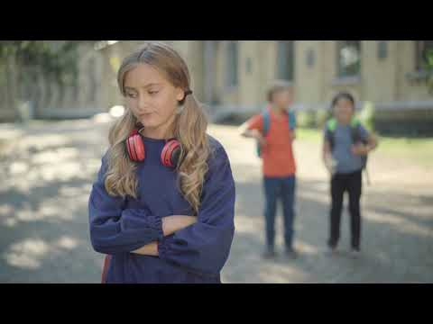
Me and Sam-Sam Handle the Apocalypse By Susan Vaught
When the cops show up at Jesse’s house and arrest her dad, she figures out in a hurry that he’s the #1 suspect in the missing library fund money case. With the help of her (first and only) friend Springer, she rounds up suspects (leading to a nasty confrontation with three notorious school bullies) and asks a lot of questions. But she can’t shake the feeling that she isn’t exactly cut out for being a crime-solving hero. Jesse has a neuro-processing disorder, which means that she’s “on the spectrum or whatever.” As she explains it, “I get stuck on lots of stuff, like words and phrases and numbers and smells and pictures and song lines and what time stuff is supposed to happen.” But when a tornado strikes her small town, Jesse is given the opportunity to show what she's really made of—and help her dad.
Told with the true-as-life voice Susan Vaught is known for, this mystery will have you rooting for Jesse and her trusty Pomeranian, Sam-Sam.

Slide 10
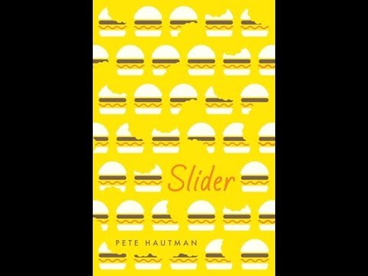
Slider by Pete Hautman
David can eat an entire sixteen-inch pepperoni pizza in four minutes and thirty-six seconds. Not bad. But he knows he can do better. In fact, he’ll have to do better: he’s going to compete in the Super Pigorino Bowl, the world’s greatest pizza-eating contest, and he has to win it, because he borrowed his mom’s credit card and accidentally spent $2,000 on it. So he really needs that prize money. Like, yesterday. As if training to be a competitive eater weren’t enough, he’s also got to keep an eye on his little brother, Mal (who, if the family believed in labels, would be labeled autistic, but they don’t, so they just label him Mal). And don’t even get started on the new weirdness going on between his two best friends, Cyn and HeyMan. Master talent Pete Hautman has cooked up a rich narrative shot through with equal parts humor and tenderness, and the result is a middle-grade novel too delicious to put down.

Slide 11
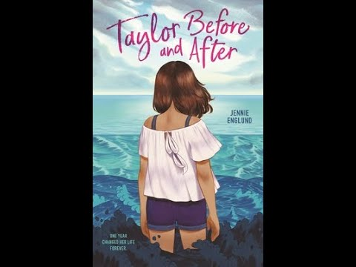
Taylor Before and After
by Jennie Englund
In journal entries alternating between two timelines―before and after a tragic accident―Jennie Englund's heartfelt coming-of-age story, Taylor Before and After follows the year that changes one girl’s life forever.
Before, Taylor Harper is finally popular, sitting with the cool kids at lunch, and maybe, just maybe, getting invited to the biggest, most exclusive party of the year.
After, no one talks to her.
Before, she’s friends with Brielle Branson, the coolest girl in school.
After, Brielle has become a bully, and Taylor’s her favorite target.
Before, home isn’t perfect, but at least her family is together.
After, Mom won’t get out of bed, Dad won’t stop yelling, and Eli...
Eli’s gone.
Through everything, Taylor has her notebook, a diary of the year that one fatal accident tears her life apart. In entries alternating between the first and second semester of her eighth-grade year, she navigates joy and grief, gain and loss, hope and depression.

Slide 12
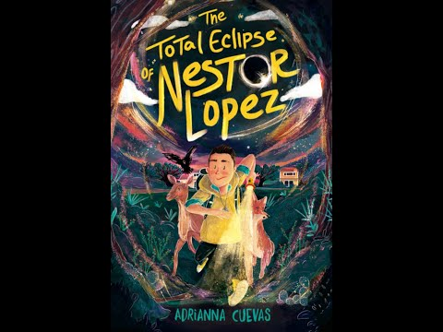
The Total Eclipse of Nestor Lopez by Adrianna Cuevas
All Nestor Lopez wants is to live in one place for more than a few months and have dinner with his dad.
When he and his mother move to a new town to live with his grandmother after his dad’s latest deployment, Nestor plans to lay low. He definitely doesn’t want to anyone find out his deepest secret: that he can talk to animals.
But when the animals in his new town start disappearing, Nestor's grandmother becomes the prime suspect after she is spotted in the woods where they were last seen. As Nestor investigates the source of the disappearances, he learns that they are being seized by a tule vieja―a witch who can absorb an animal’s powers by biting it during a solar eclipse. And the next eclipse is just around the corner…
Now it’s up to Nestor’s extraordinary ability and his new friends to catch the tule vieja―and save a place he might just call home.

Slide 13
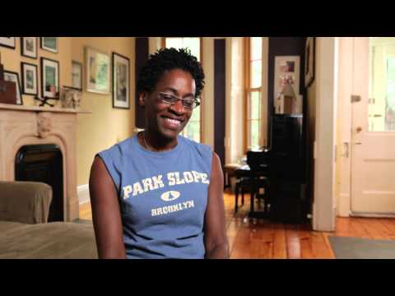
Brown Girl Dreaming
by Jacqueline woodson
Raised in South Carolina and New York, Woodson always felt halfway home in each place. In vivid poems, she shares what it was like to grow up as an African American in the 1960s and 1970s, living with the remnants of Jim Crow and her growing awareness of the Civil Rights movement. Touching and powerful, each poem is both accessible and emotionally charged, each line a glimpse into a child’s soul as she searches for her place in the world. Woodson’s eloquent poetry also reflects the joy of finding her voice through writing stories, despite the fact that she struggled with reading as a child. Her love of stories inspired her and stayed with her, creating the first sparks of the gifted writer she was to become.

Slide 14
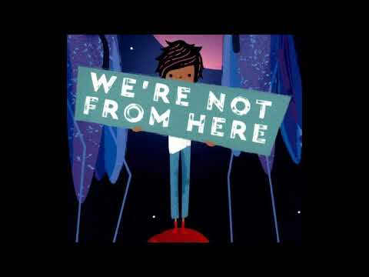
We’re Not From Here
by Geoff Rodkey
The first time I heard about Planet Choom, we'd been on Mars for almost a year. But life on the Mars station was grim, and since Earth was no longer an option (we may have blown it up), it was time to find a new home.
That's how we ended up on Choom with the Zhuri. They're very smart. They also look like giant mosquitoes. But that's not why it's so hard to live here. There's a lot that the Zhuri don't like: singing (just ask my sister, Ila), comedy (one joke got me sent to the principal's office), or any kind of emotion. The biggest problem, though? The Zhuri don't like us. And if humankind is going to survive, it's up to my family to change their minds.
No pressure.

Slide 15
Tristan Strong Punches a Hole In the Sky By Kwame Mbalia
Seventh grader Tristan Strong feels anything but strong ever since he failed to save his best friend when they were in a bus accident together. All he has left of Eddie is the journal his friend wrote stories in. Tristan is dreading the month he's going to spend on his grandparents' farm in Alabama, where he's being sent to heal from the tragedy.
But on his first night there, a sticky creature shows up in his bedroom and steals Eddie's notebook. Tristan chases after it--is that a doll?--and a tug-of-war ensues between them underneath a Bottle Tree. In a last attempt to wrestle the journal out of the creature's hands, Tristan punches the tree, accidentally ripping open a chasm into the MidPass, a volatile place with a burning sea, haunted bone ships, and iron monsters that are hunting the inhabitants of this world.
Tristan finds himself in the middle of a battle that has left black American folk heroes John Henry and Brer Rabbit exhausted. In order to get back home, Tristan and these new allies will need to entice the god Anansi, the Weaver, to come out of hiding and seal the hole in the sky. But bartering with the trickster Anansi always comes at a price.
Can Tristan save this world before he loses more of the things he loves?

Slide 16
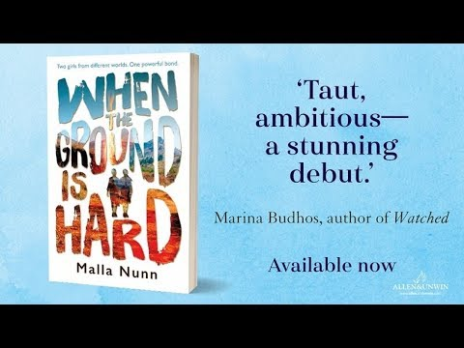
When the Ground is Hard
by Malla Nunn
Adele Joubert loves being one of the popular girls at Keziah Christian Academy. She knows the upcoming semester at school is going to be great with her best friend Delia at her side. Then Delia dumps her for a new girl with more money, and Adele is forced to share a room with Lottie, the school pariah, who doesn't pray and defies teachers' orders.
But as they share a copy of Jane Eyre, Lottie's gruff exterior and honesty grows on Adele, and Lottie learns to be a little sweeter. Together, they take on bullies and protect each other from the vindictive and prejudiced teachers. Then a boy goes missing on campus and Adele and Lottie must rely on each other to solve the mystery and along the way learn the true meaning of friendship.

Slide 17
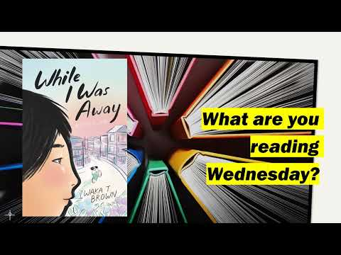
While I Was Away
by Waka T. Brown
When twelve-year-old Waka’s parents suspect she can’t understand the basic Japanese they speak to her, they make a drastic decision to send her to Tokyo to live for several months with her strict grandmother. Forced to say goodbye to her friends and what would have been her summer vacation, Waka is plucked from her straight-A-student life in rural Kansas and flown across the globe, where she faces the culture shock of a lifetime.
In Japan, Waka struggles with reading and writing in kanji, doesn’t quite mesh with her complicated and distant Obaasama, and gets made fun of by the students in her Japanese public-school classes. Even though this is the country her parents came from, Waka has never felt more like an outsider.
If she’s always been the “smart Japanese girl” in America but is now the “dumb foreigner” in Japan, where is home...and who will Waka be when she finds it?

